Slide 1
MOHAMMAD Al-assaf Task 1
Cellula Technologies

Slide 2
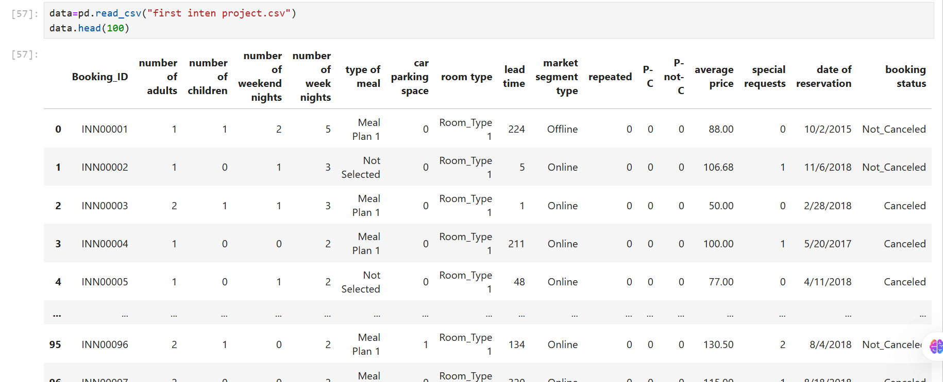
Methodology followed
Overview data
-we have 17 column divided between categoric and numeric columns

Slide 3
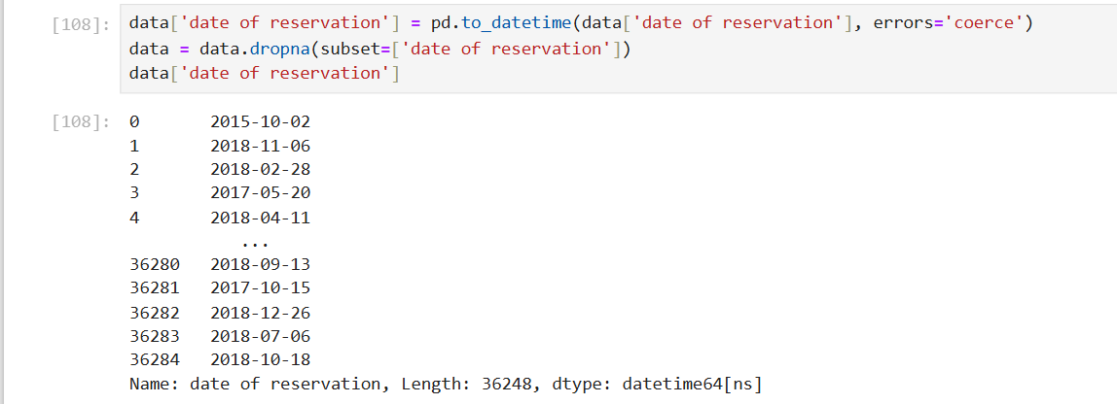
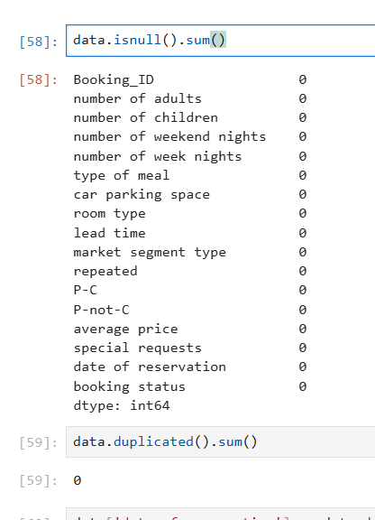
Missing value and duplicate data cheak
We notice that there are no missing values or duplicates, and this is a good indicator that makes our analysis easier.
DateTime format
Convert the date format to a format understandable for analysis and training.

Slide 4
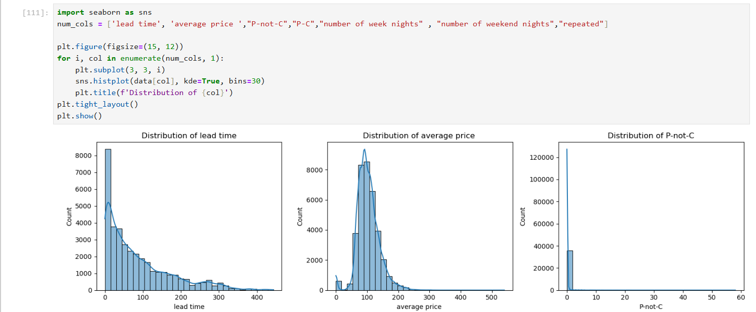
Analyzing visualizations and their relationship with the target variable
Divide data to numeric and categoric column
Lead time : most customers
book 50 days in advance
but few book early.
Average price : there are
very few reservations at high
prices , which means little
demand for VIP categories.
PC and P not C :
most of those who booked
did not cancel.

Slide 5
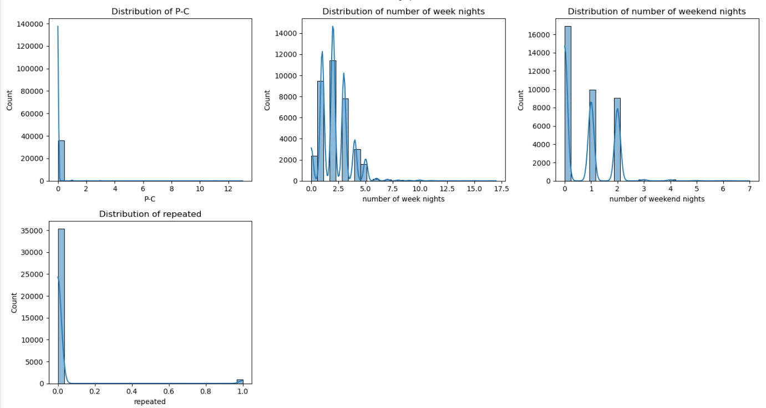
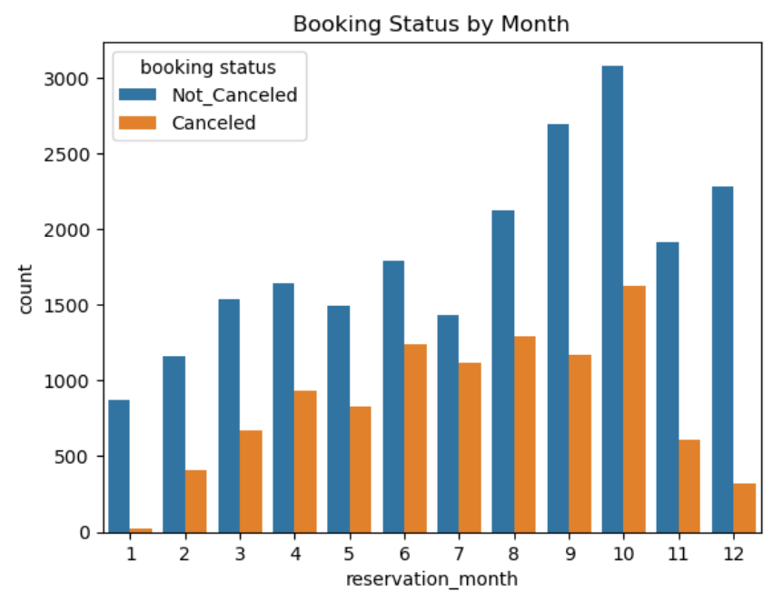
Number of week nights : the peak of bookings typically ranges from one to three nights , indicating that customers prefer short stays .
number of weekend nights : the highest proportion is at zero , which indicates that most customers do not book over the weekend , and a large number tend to book only one or two .
Date of reservation : we notice an increase in the number of reservations form January to October , and most of the reservations are in October during
the summer and holidays. Also , the more the
number of reservations , the more the number of
cancellations .

Slide 6
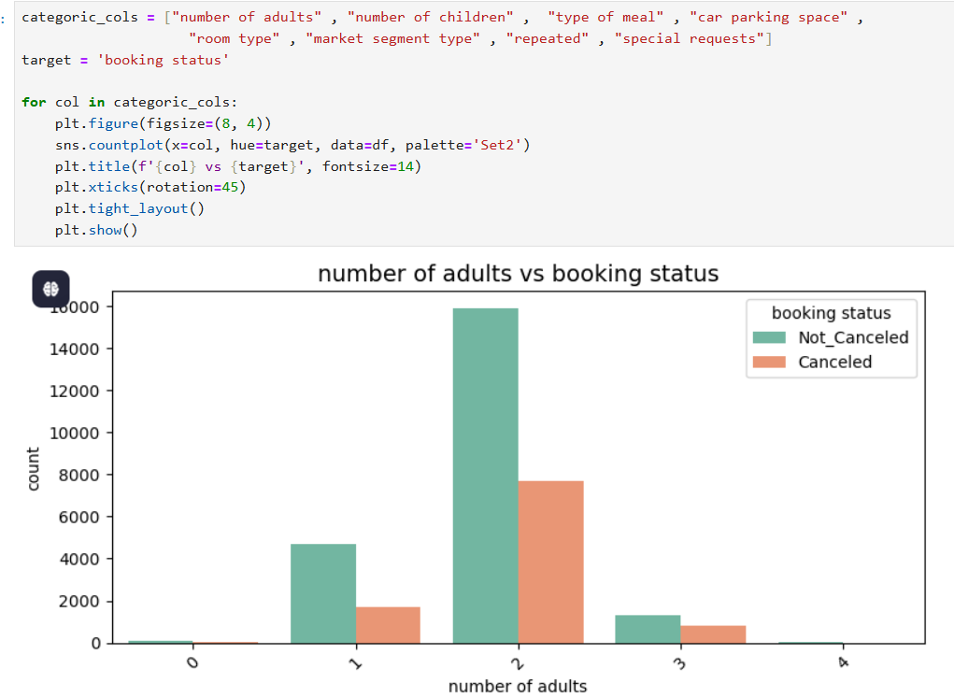
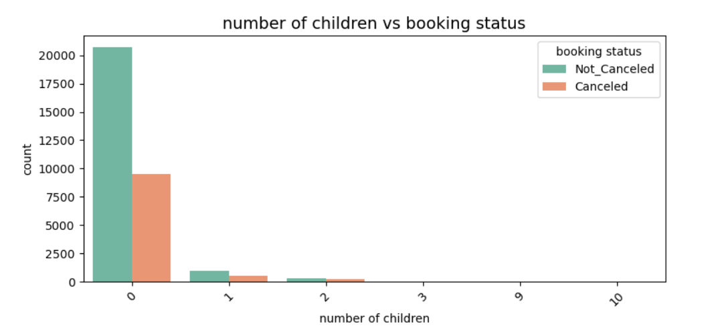
Categoric Columns :
Number of adults : category 2 is the largest , and we observe that the cancellation rate is higher when the booking is for two people .
Number of children : most booking are made without children , and when children are included , the cancellation rate tends to increase.

Slide 7
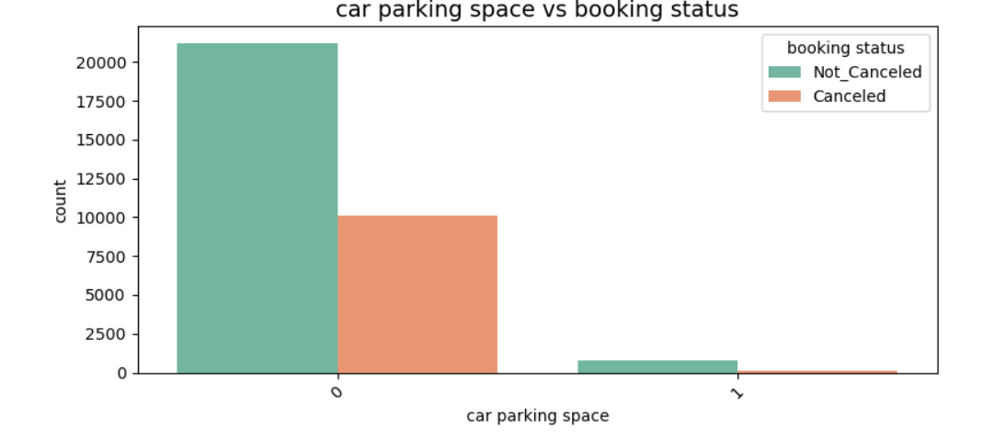
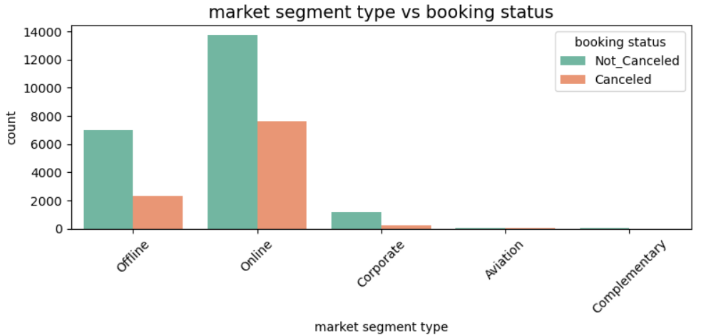
Car parking space : most customers do not request a parking space, and the cancellation rate among them is relatively low. This suggests that guests without a car have limited mobility, which may lead them to remain at the hotel and avoid canceling their reservations.
Market segment : the highest booking rate comes from online reservations, and the cancellation rate for these bookings is relatively low.

Slide 8
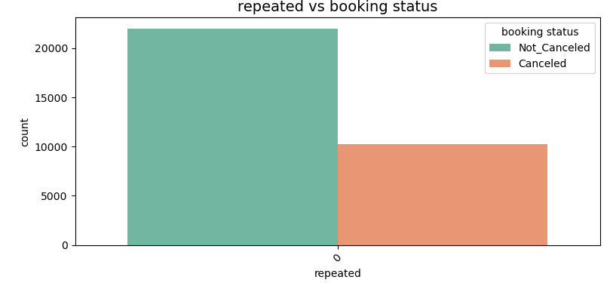
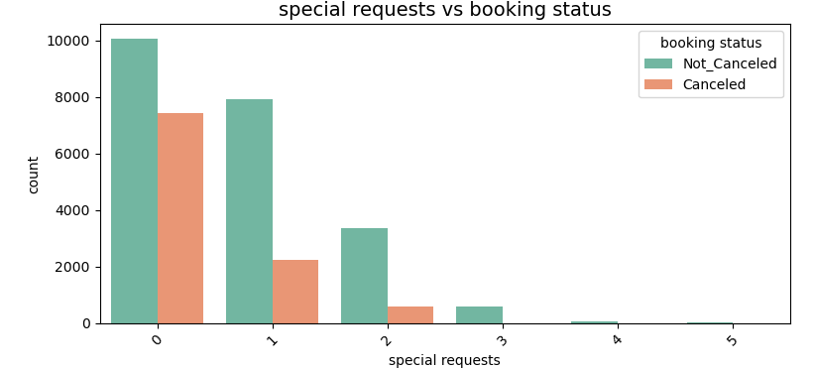
Repeated : the cancellation rate is low among new visitors.
Special request : as the number of special requests increases, the cancellation rate decreases. This suggests that customers who make special requests are more serious about their stay and less likely to cancel.

Slide 9
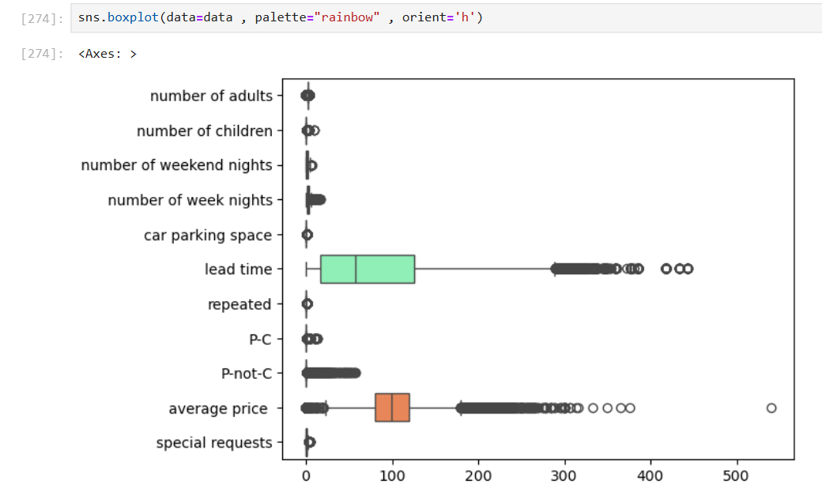
Outliers handle
We have lots of outliers

Slide 10
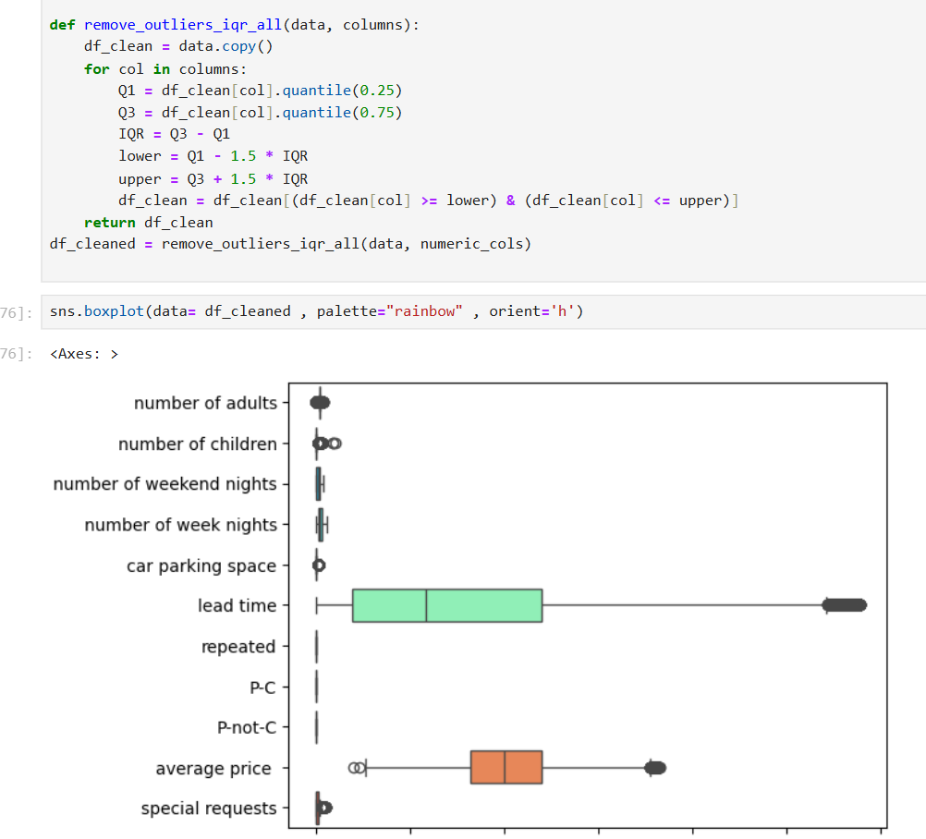
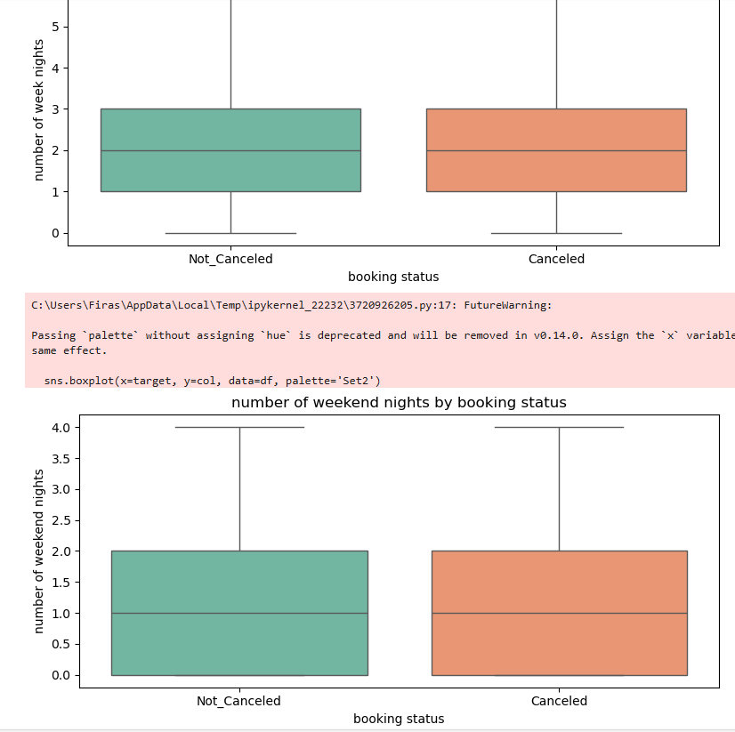
Iqr
See the outliers are reduced

Slide 11
Thank you
Author By : Mohammad Alassaf

